Slide 1
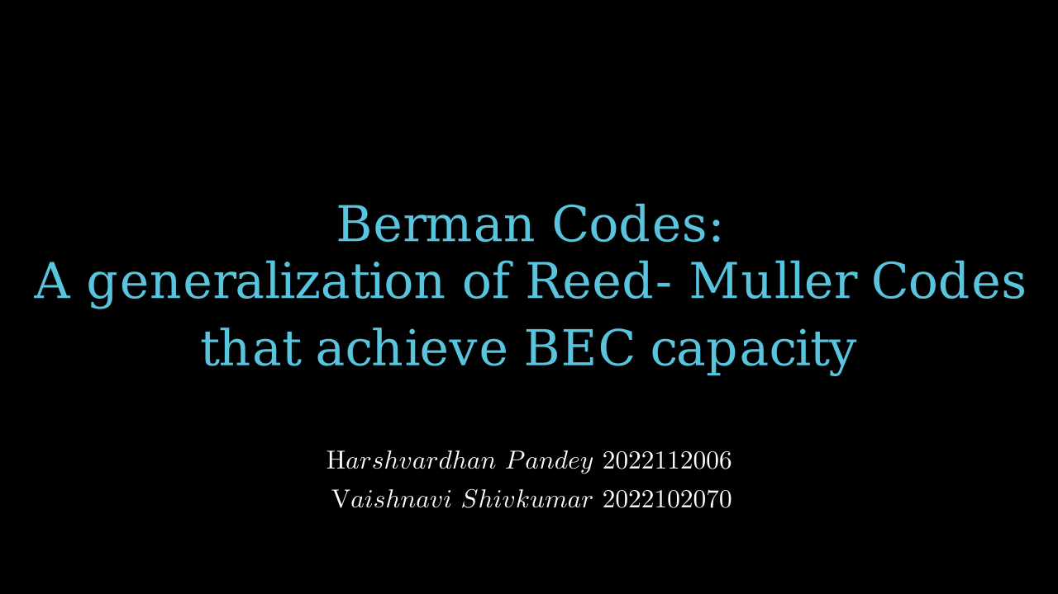

Slide 2
Problem Statement
Sending Data through Space and Time results in corruption of data.
We are considering a BEC (Binary Erasure Channel)
In a BEC, How do we reconstruct lost data, to the best of our capabilities, in such a way that we receive maximum information about our original message signal?

Slide 3
Problem Statement
Sending Data through Space and Time results in corruption of data.
We are considering a BEC (Binary Erasure Channel)
In a BEC, How do we reconstruct lost data, to the best of our capabilities, in such a way that we receive maximum information about our original message signal?

Slide 4


Slide 5
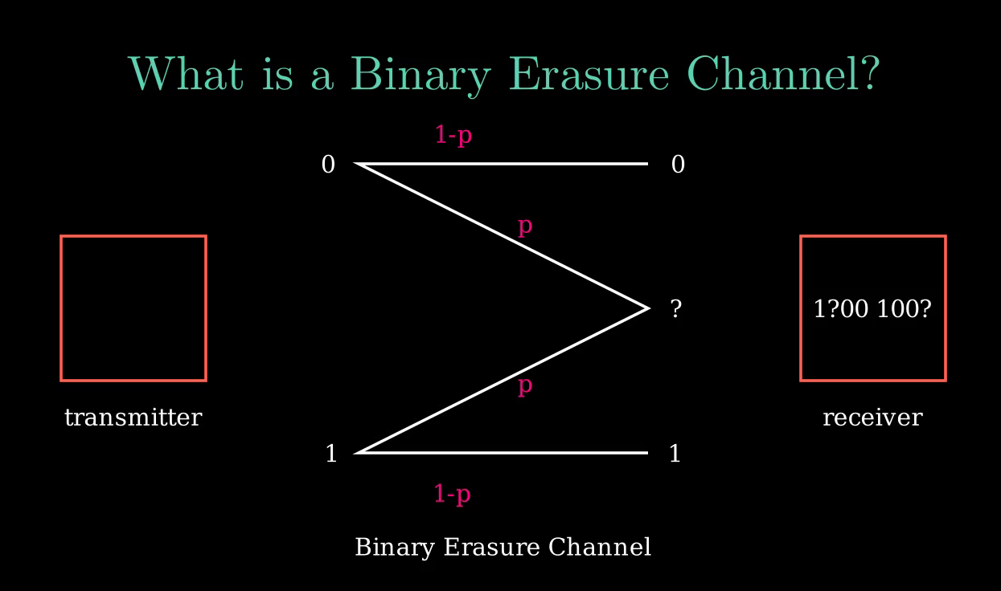
In a binary erasure channel, A bit retains its configuration with a probability 1-p, and becomes erased with a probability p.

Slide 6
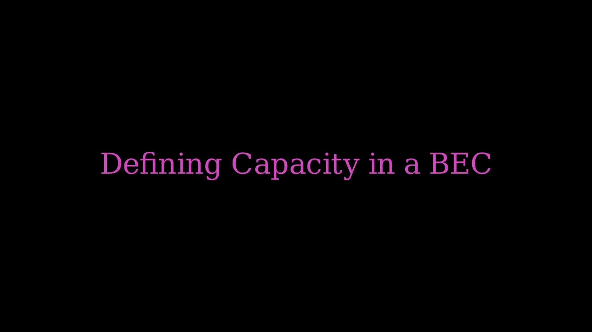

Slide 7
Encoding a message:

Slide 8
Defining P_{error}(n)

Slide 9
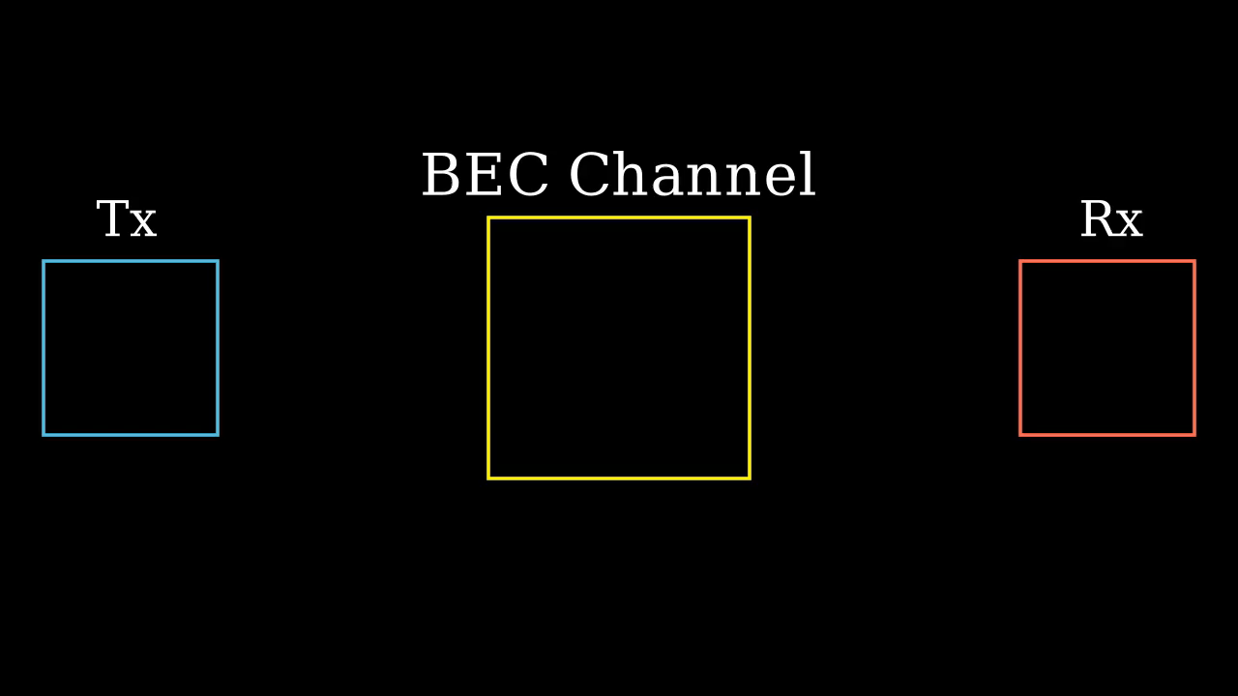
Defining Rate:

Slide 10
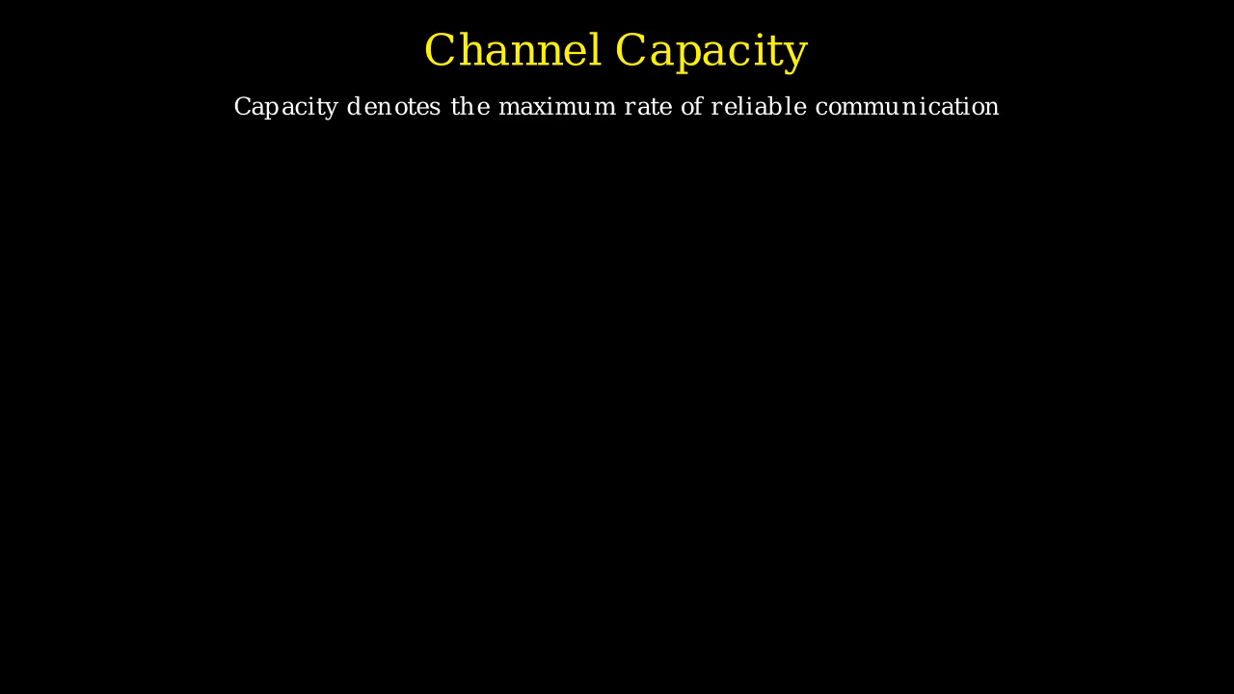
Capacity:

Slide 11
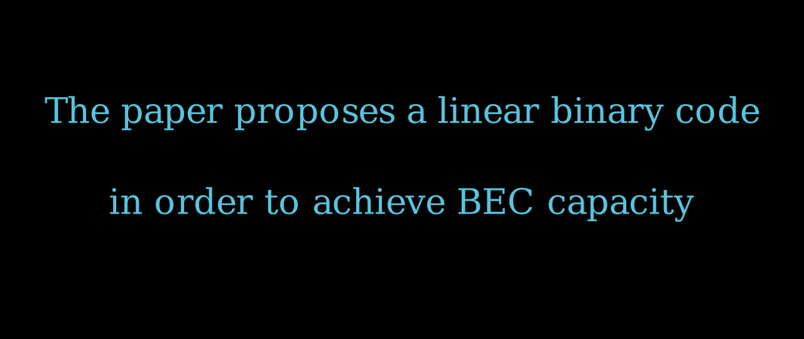

Slide 12
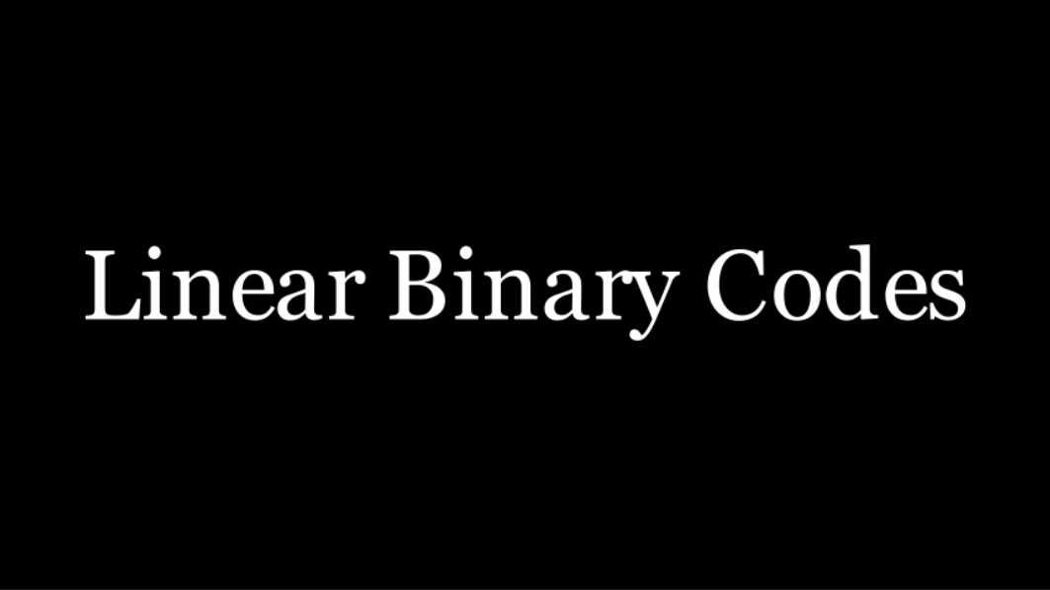

Slide 13


Slide 15
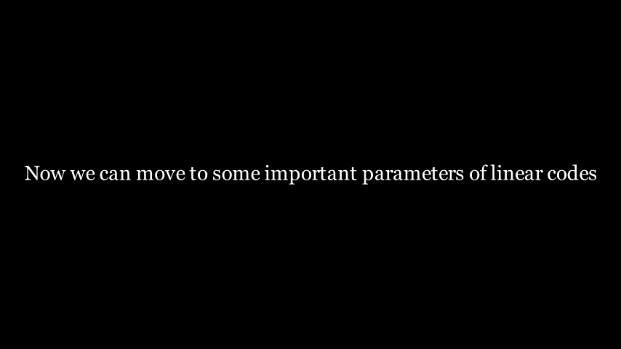

Slide 16
We identify a family of binary linear codes, called Berman Codes.
We will denote the code with parameters n, r, m where n and m determine the length of the code.
The following is the code:

Slide 17
We can define the dual of the Berman code as:

Slide 19
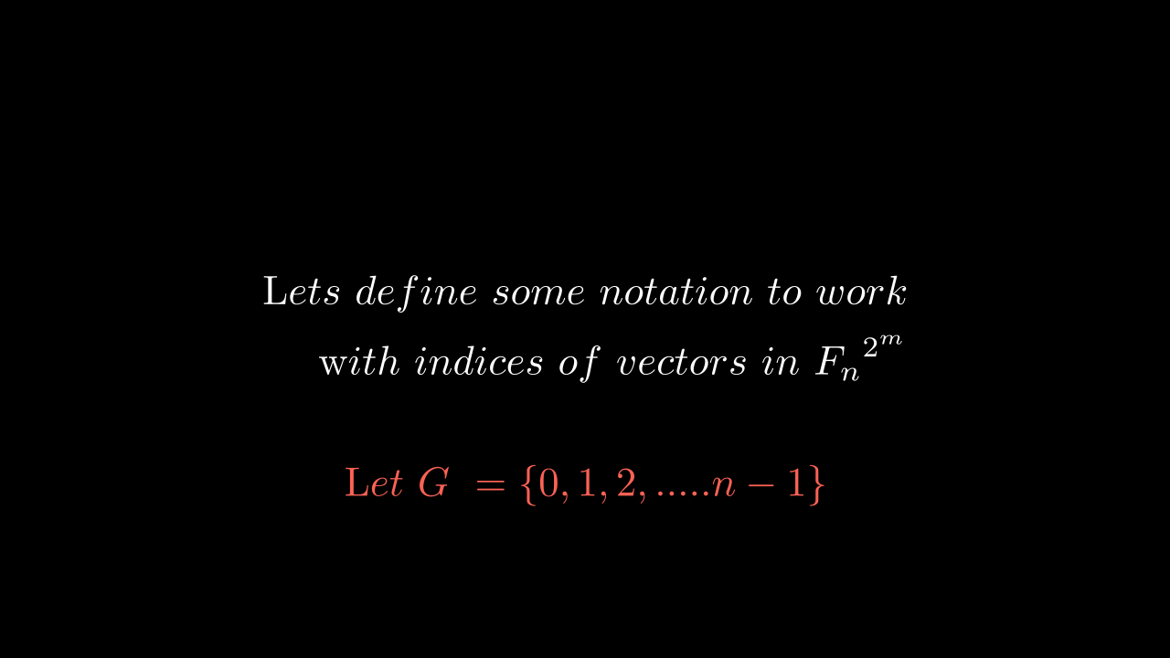

Slide 23
